Slide 1
Route Data Processing Steps
By S. Brennan and L. Gao
Last Updated: 2021_10_15

Slide 2
The goal of this presentation is to document and explain the data processing steps used for a typical mapping of a route.
Add Google Earth pics of Wahba and test track routes

Slide 3
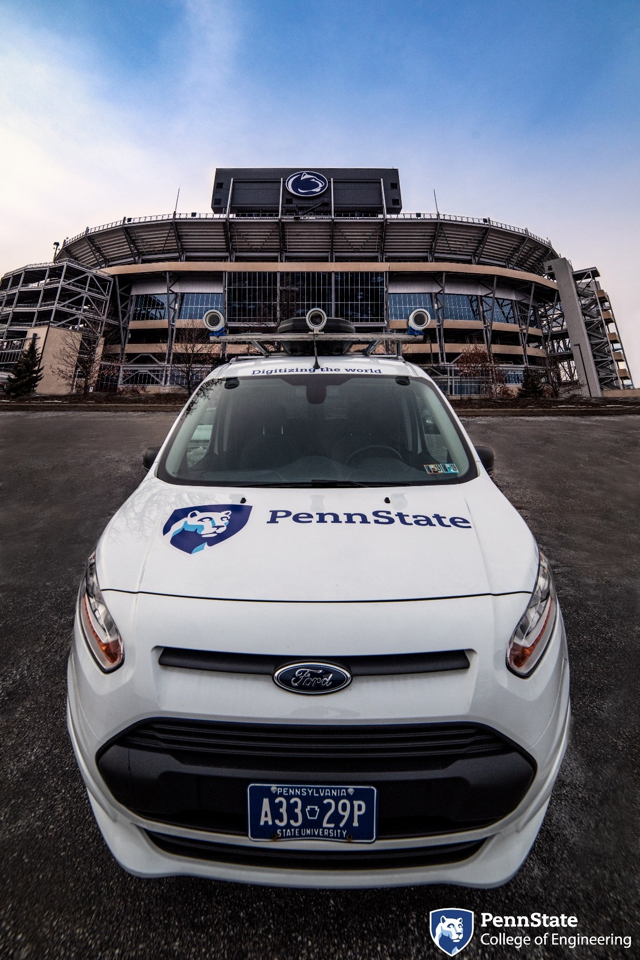
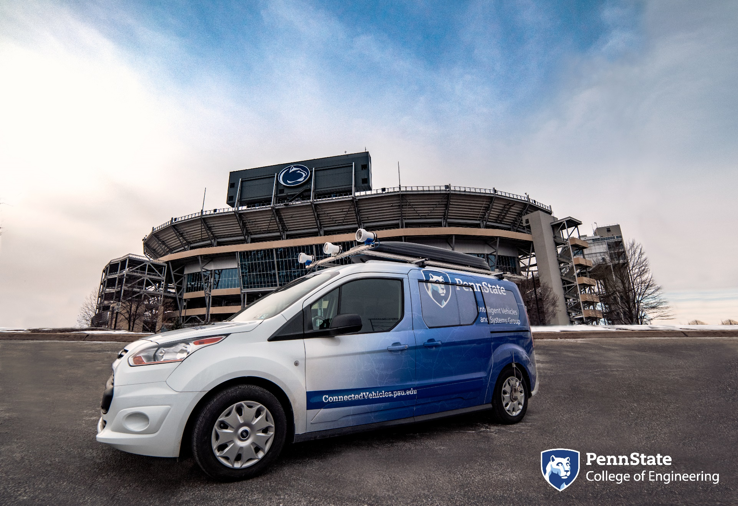
This pertains to the Penn State Mapping van

Slide 4
The mapping van has the following sensors
Details can be found at: www.connectedvehicles.psu.edu

Slide 5
The overview of the steps follow grouping of data into increasingly processed forms
Crude data by indices By time Aligned Merged

Slide 6
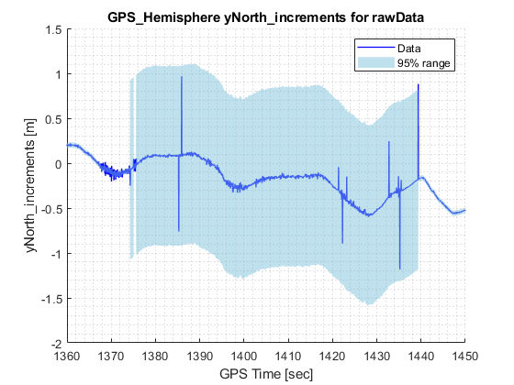
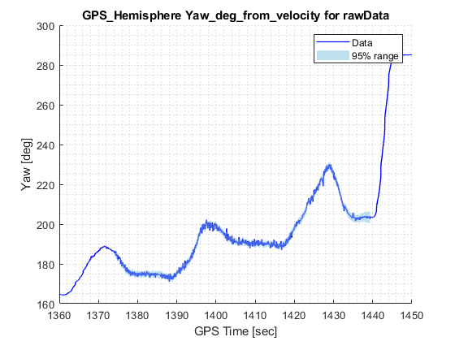
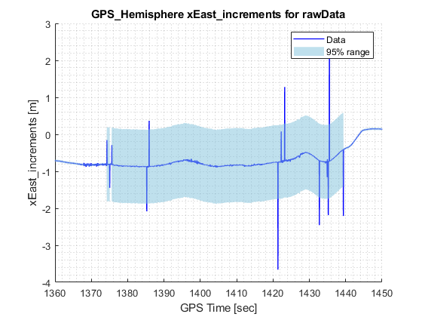
First, we load all data into structure with fields grouped by sensor. This is the rawData structure.
We do this because all data for each sensor individually tends to share the same error behaviors. For example, data from the Hemisphere GPS all tend to drop at the same time, if DGPS goes out.

Slide 7
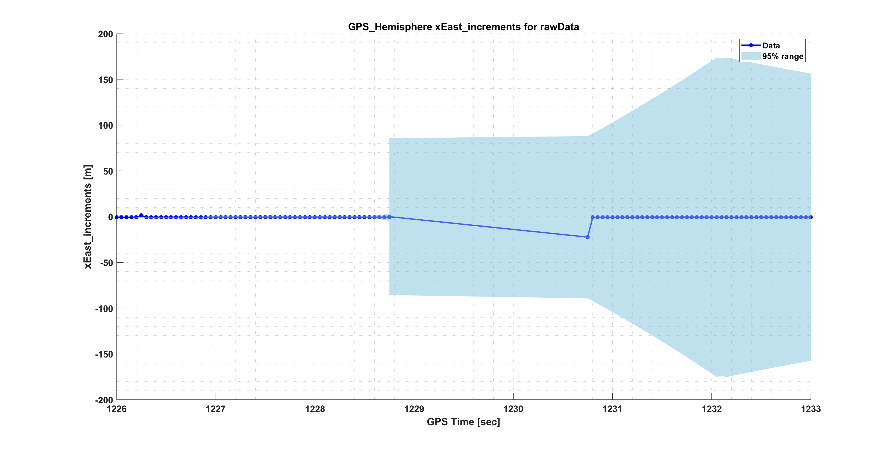
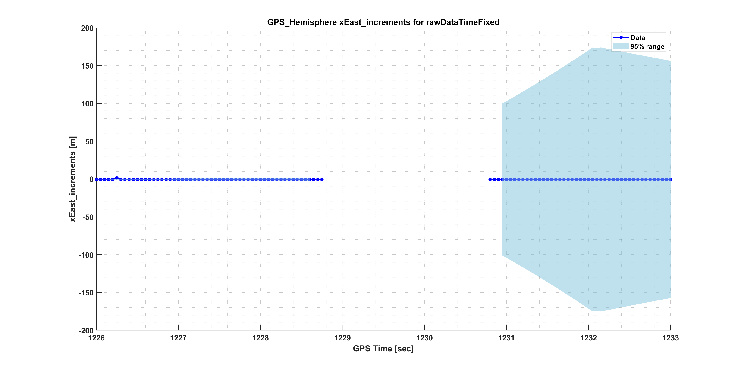
Right after the raw data is loaded, we check if the time is incrementing uniformly in fcn_removeTimeGapsFromRawData. If it does not, the data around this is set to NaN. In later steps, this is interpolated.

Slide 8
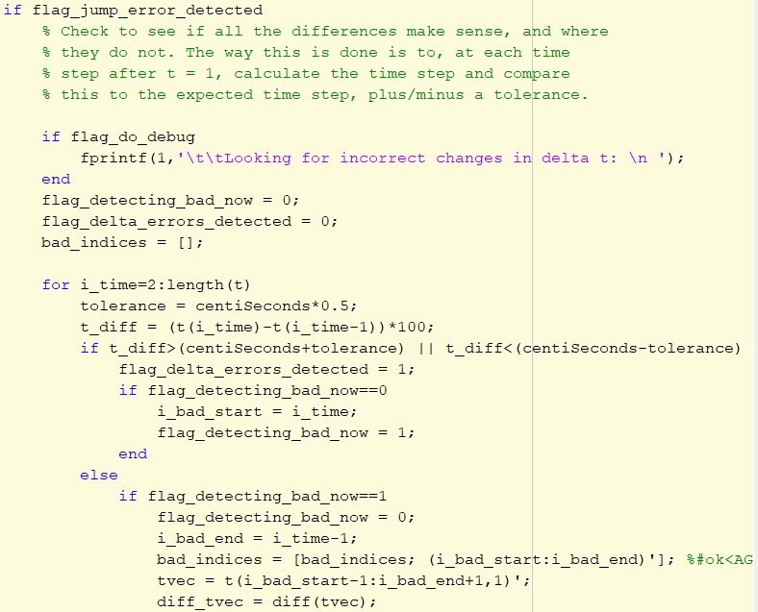
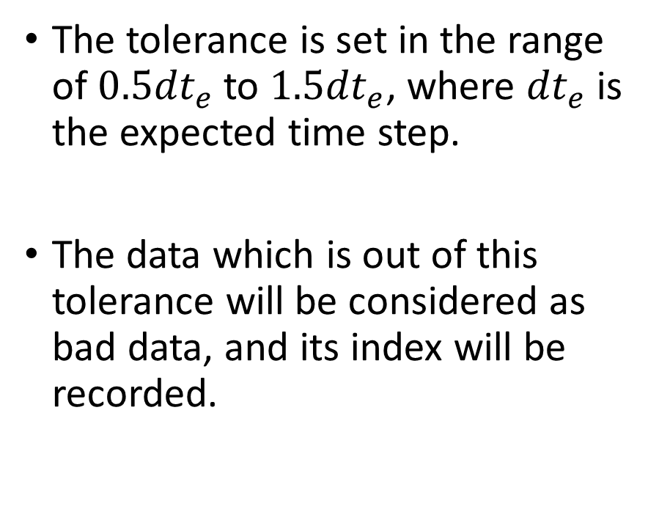
To determine the indices of bad data, fcn_removeTimeGapsFromRawData calculates each time step and check whether it is within the tolerance.
The tolerance is set in the range of $0.5{dt}_{e}$ to $1.5{dt}_{e}$, where ${dt}_{e}$ is the expected time step.
The data which is out of this tolerance will be considered as bad data, and its index will be recorded.

Slide 9
The function works properly with GPS time, however, it failed when ROS time is used.
For example, apply the function to yaw rate data from IMU Novatel with GPS time and ROS time separately, massive data loss can be noticed when ROS time is used.

Slide 10
We check the distribution of time increments for GPS time and ROS time, it can be noticed that for ROS time, the majority data lie outside the tolerance, which will be considered as bad data and result in massive data loss.

Slide 11
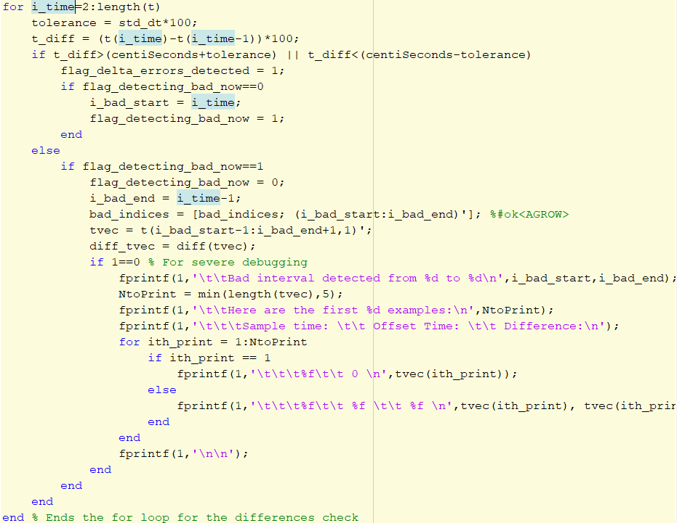
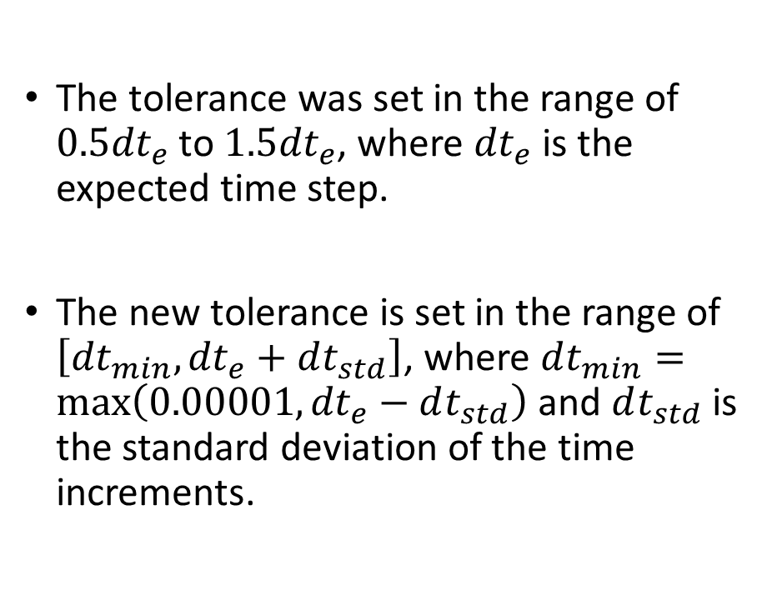
We temporarily fix this error by increasing the that used to determine the bad data.
The tolerance was set in the range of $0.5{dt}_{e}$ to $1.5{dt}_{e}$, where ${dt}_{e}$ is the expected time step.
The new tolerance is set in the range of $\left[dt_{min},{dt}_{e}+dt_{std}\right]$, where $dt_{min}=\max\left(0.00001,{dt}_{e}−dt_{std}\right)$ and $dt_{std}$ is the standard deviation of the time increments.

Slide 12
After increasing the tolerance, it can be noticed that the majority data lie inside the tolerance, which can decrease the number of bad data.

Slide 13
Here’s that same data from IMU Novatel, after increasing the tolerance.
Result with old tolerance
Result with new tolerance

Slide 14
Another example is using yaw rate data from IMU ADIS, after increasing the tolerance, only a small amount of data was resampled.
Result with old tolerance
Result with new tolerance

Slide 15
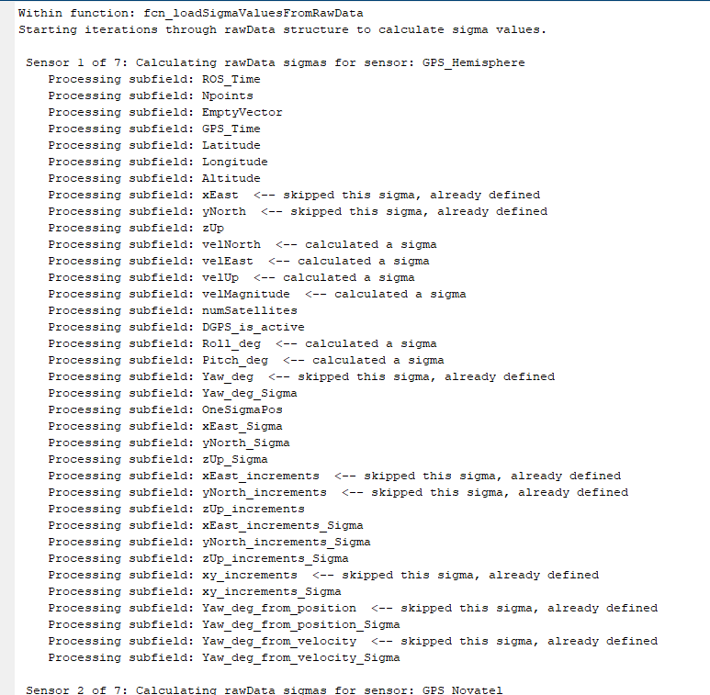
Next: assign to each data a measured or calculated variance. This is the rawDataWithSigmas structure, via function: fcn_loadSigmaValuesFromRawData
If data has Sigmas assigned within raw data, these should be filled in and are skipped here.
If not, they are filled in here.

Slide 16
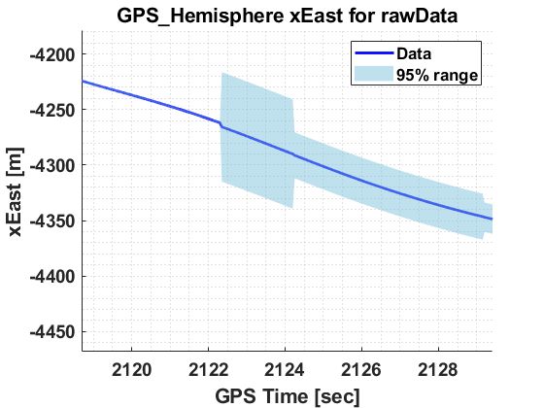
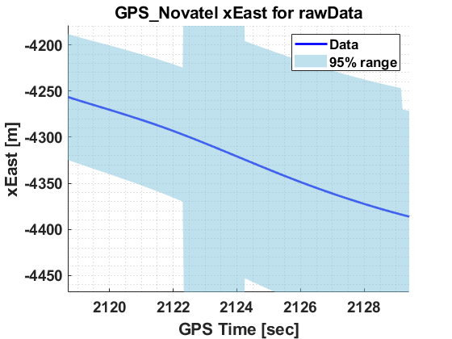
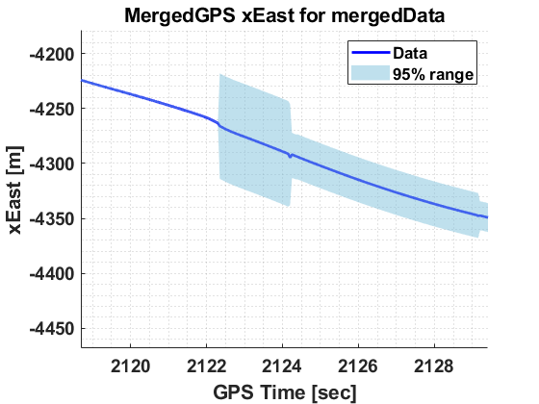
One thing to be careful about when adding variance is that the change in variance must be smooth, like the data. Otherwise, the weighted average can produce jumps, even when the data itself does not have a jump discontinuity. Here’s an example of this causing about a 1 meter jump (before this bug was fixed).

Slide 17
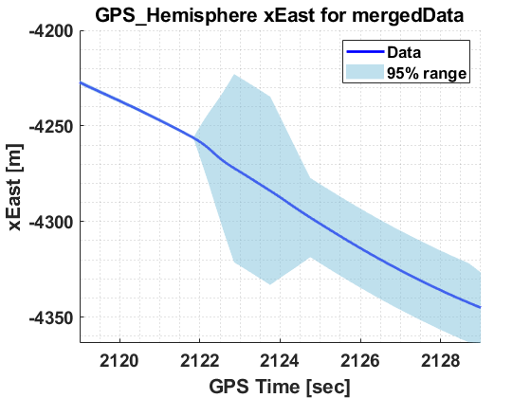
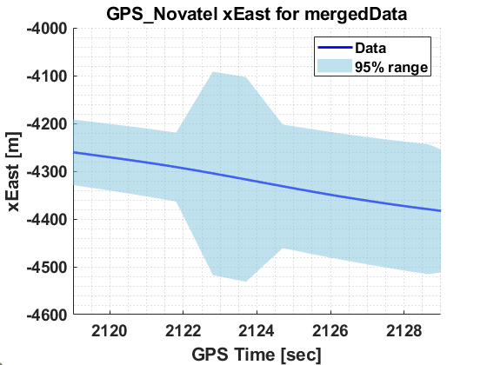
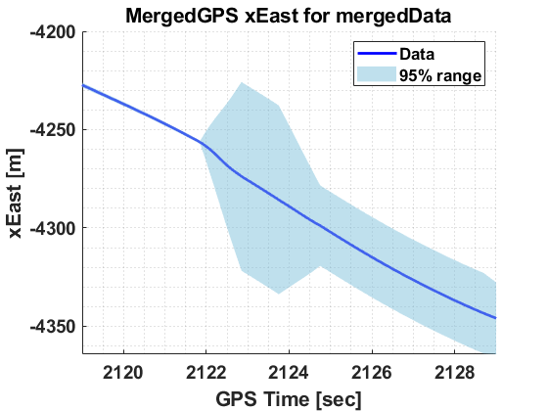
Here’s that same location, after fixing the variance to not be discontinuous.

Slide 18
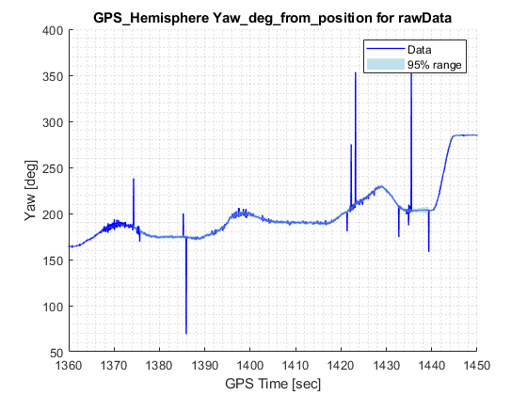
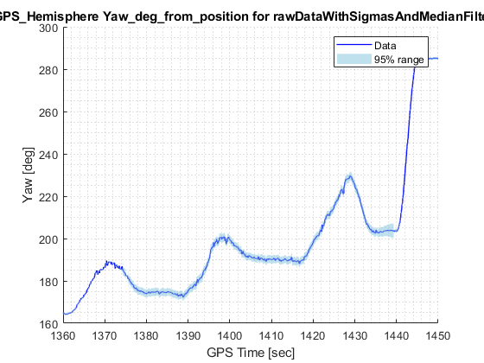
Step 3: Remove outliers via Median filtering. This is the rawDataWithSigmasAndMedianFiltered data structure

Slide 19
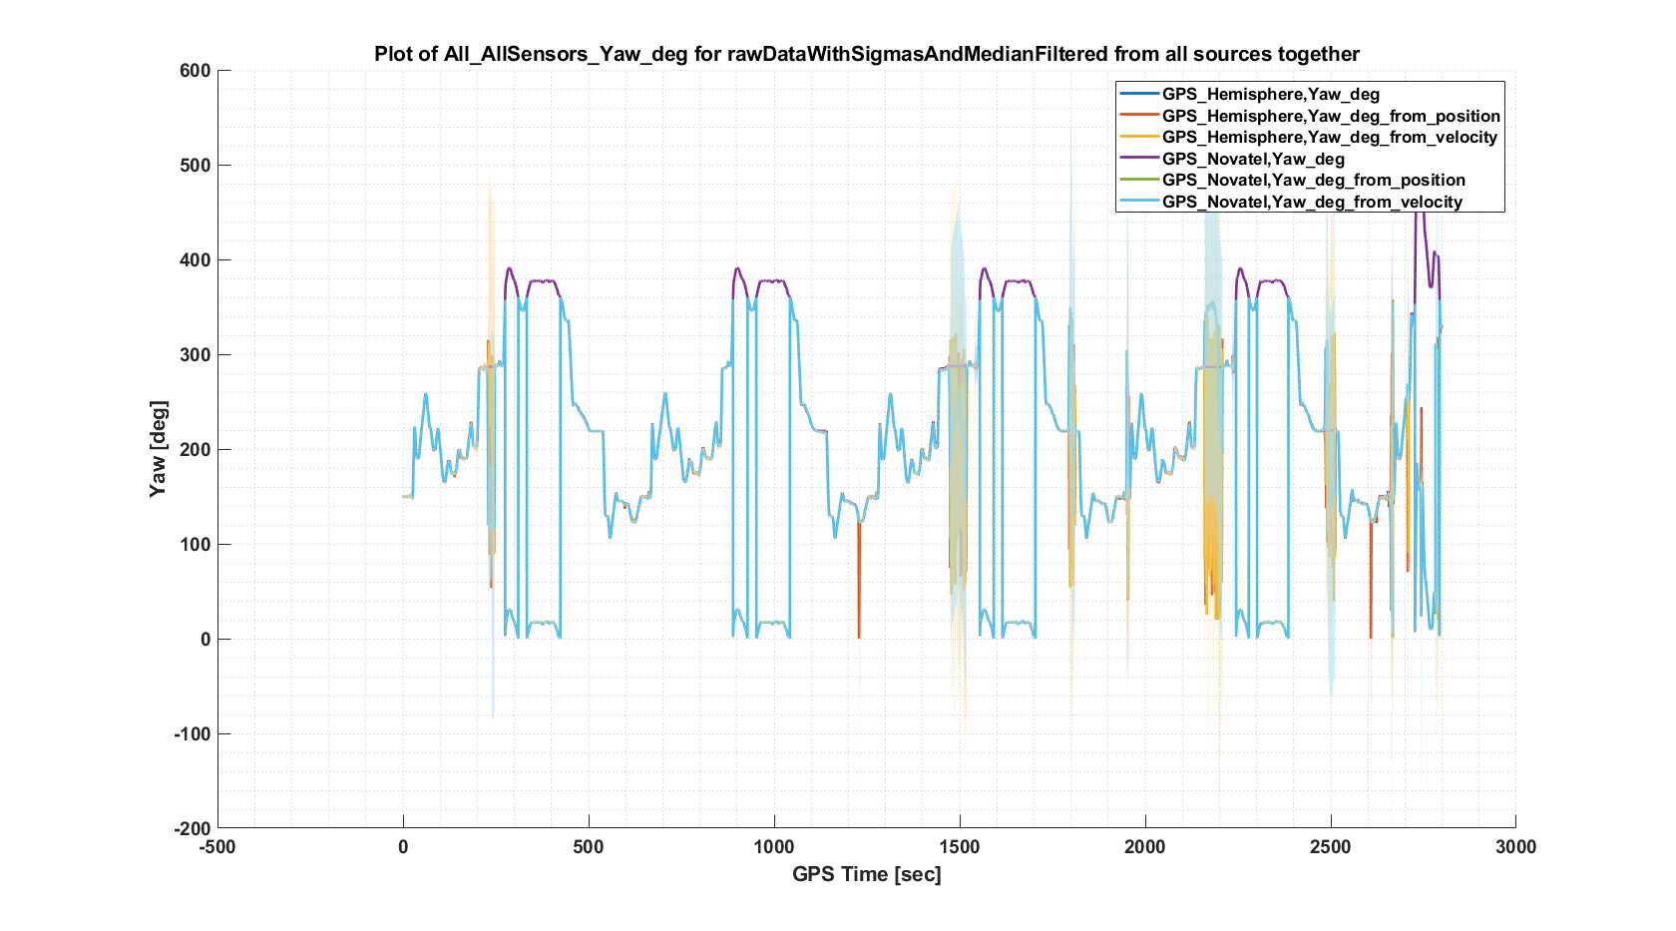
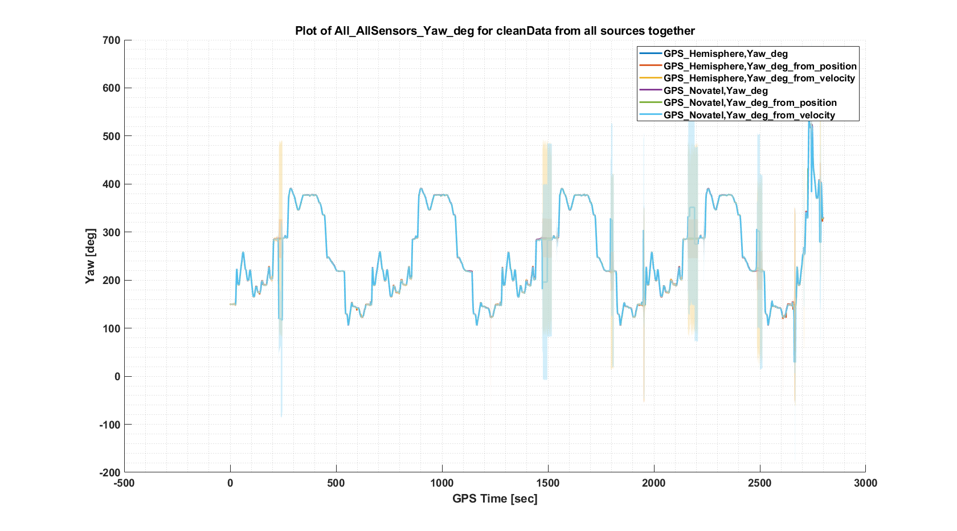
Step 4: Remove additional data artifacts such as yaw angle wrapping. This is the cleanData structure. This has to be done before filtering to avoid smoothing these artificial discontinuities.

Slide 20
Step 4a: Much of the cleaning process is focused on yaw angle. For fcn_cleanGPSData, the Step 4a is to unwrap the yaw angle, i.e. keep it from jumping from 0 to 359 degrees.
%%
function unwrapped_angle = fcn_unwrapAngles(wrapped)
initial_angle = wrapped(1,1); % Grab the first angle
change_in_angle = [0; diff(wrapped)]; % Use diff to find jumps
index_jumps = find(change_in_angle>180); % Tag jumps greater than 180
change_in_angle(index_jumps) = change_in_angle(index_jumps)-360; % Shift these down
index_jumps = find(change_in_angle<-180); % Tag jumps less than -180
change_in_angle(index_jumps) = change_in_angle(index_jumps)+360; % Shift these up
unwrapped_angle = cumsum(change_in_angle) + initial_angle; % Re-add jumps
% After above process, data may be shifted up or down by multiples of 360,
% so shift all data back so mean is between zero and 360
mean_angle = mean(unwrapped_angle);
good_mean = mod(mean_angle,360);
shift = mean_angle - good_mean;
unwrapped_angle = unwrapped_angle - shift;

Slide 21
Step 4b: The next part of the cleaning process addresses zeros that appear in the yaw data, particularly from Hemisphere GPS.

Slide 22
Step 4b: The next part of the cleaning process addresses zeros that appear in the yaw data, particularly from Hemisphere GPS.

Slide 23
This is done by searching within a tolerance and replacing by the nearest neighbor.
% STEP 2: Remove solid zeros
good_indices = find(abs(unwrapped_yaw)>0.000000001); % Set a very low tolerance...
dezeroed_yaw = fcn_replaceBadIndicesWithNearestGood(unwrapped_yaw,good_indices);
function new_data = fcn_replaceBadIndicesWithNearestGood(data,good_indices)
new_data = data; % Pre-fill new data
all_indices = (1:length(data))'; % Grab all indices
moved_enough = ismember(all_indices,good_indices); % Tag bad ones
for i = 1:length(moved_enough) % Loop through indices
if 0==moved_enough(i) % Check if bad one
% Find closest index to stationary one that can work
distances = (i-good_indices).^2;
[~,index] = min(distances);
best_index = good_indices(index);
new_data(i,1) = data(best_index,1);
end
end
end

Slide 24
Step 4c: There are many locations where the yaw is noisy due to non-movement. The kinematics of the vehicle are used to impose constraints that prevent apparent motion when the vehicle is not moving.

Slide 25
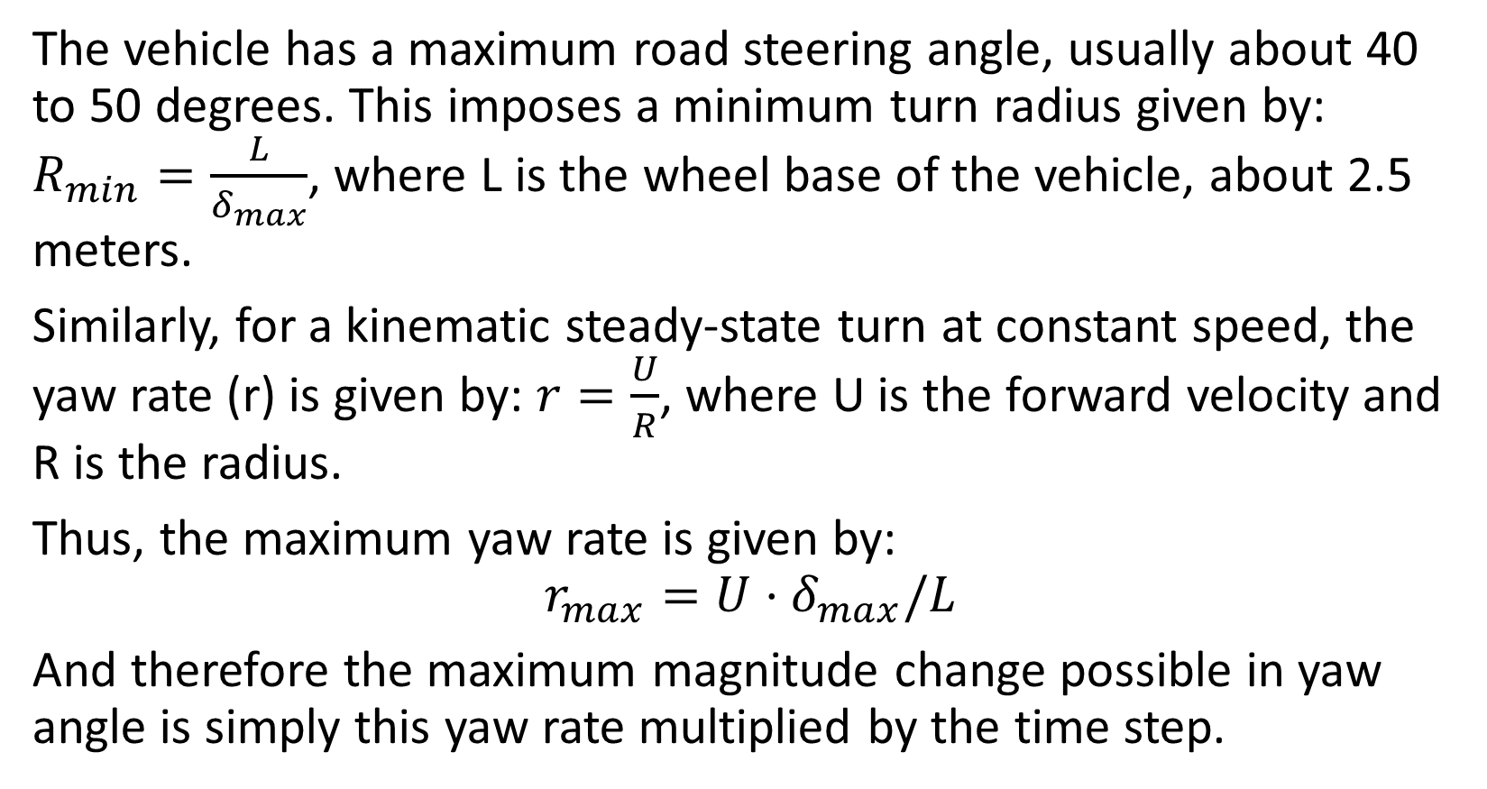
Kinematic filtering ensures that the kinematics of the vehicle are used to impose constraints.
The vehicle has a maximum road steering angle, usually about 40 to 50 degrees. This imposes a minimum turn radius given by: $R_{min}=\frac{L}{δ_{max}}$, where L is the wheel base of the vehicle, about 2.5 meters.
Similarly, for a kinematic steady-state turn at constant speed, the yaw rate (r) is given by: $r=\frac{U}{R}$, where U is the forward velocity and R is the radius.
Thus, the maximum yaw rate is given by:
$$r_{max}=U⋅δ_{max}/L$$
And therefore the maximum magnitude change possible in yaw angle is simply this yaw rate multiplied by the time step.

Slide 26
A threshold of 2 mph is needed to prevent “ghost” speed measurements. This gives the following results.
function kinematic_yaw = fcn_enforceKinematicYawLimits(yaw,t, U,U_limit)
U(U<U_limit) = 0; % Set the slow speeds to zero - can't trust GPS slower than this
L = 2.5; % Typical wheelbase in meters
maxsteer = 40*pi/180; % Maximum steering angle magnitude is about 40 degrees
maxyawrate = U * maxsteer/L; % The kinematics limit
kinematic_yaw = yaw; % Initialize the variable
for i_time = 2:length(kinematic_yaw) % Loop through variables
delta_t = t(i_time) - t(i_time-1); % Calculate delta t
yaw_max = kinematic_yaw(i_time-1,1) + maxyawrate(i_time,1)*delta_t*180/pi;
yaw_min = kinematic_yaw(i_time-1,1) - maxyawrate(i_time,1)*delta_t*180/pi;
if kinematic_yaw(i_time,1) > yaw_max
kinematic_yaw(i_time,1) = yaw_max;
elseif kinematic_yaw(i_time,1) < yaw_min
kinematic_yaw(i_time,1) = yaw_min;
end
end
end

Slide 27

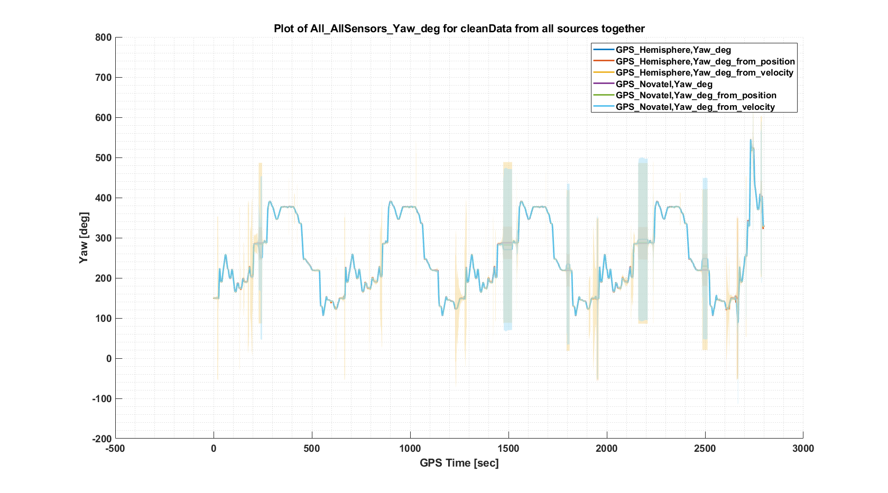
Here are the overall results for yaw angle

Slide 28
Step 5: Time align the data to GPS time (not ROS time). This is the cleanAndTimeAlignedData structure.
This step aligns all the time vectors to GPS time, and ensures that the data has an even time sampling.

Slide 29
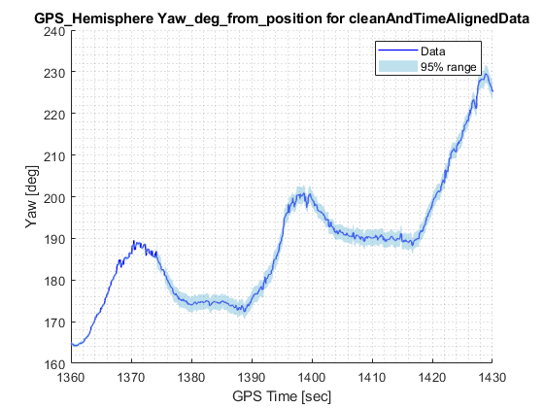
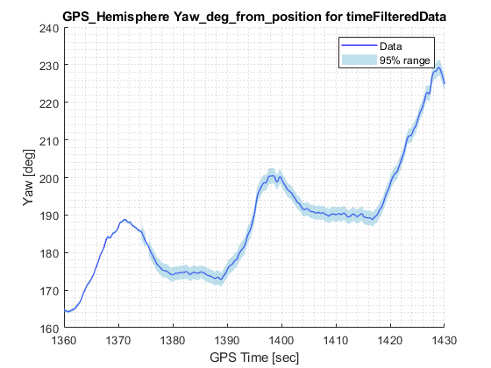
Step 6: Time filter the data. This is the timeFilterData structure.
This part is difficult, because the eigenvalues of the vehicle model change with speed (become slower). For now, a constant 2nd-order filter is used, with cutoff frequency of 1 Hz.

Slide 30
Ultimately, we should use the eigenvalues of the closed-loop dynamics, which can be calculated from the bicycle model
This turns out to be the same as the denominator of the transfer function from input to any measured output.

Slide 31
Step 7: Merge each signal by those that are common along the same state. This is in the structure mergedData

Slide 32
Step 8: Merge the data via Kalman Filtering. Step 1 is to merge Yaw and YawRate, and Velocity - generally. This is in the structure mergedByKFData
A bug:
TripName:Altoona to State College MappingVan 2021-01-23. Start_time:2021-01-23 15:02:34.0. End_time:2021-01-23 15:45:41.0

Slide 33
Step 9: Perform kinematic filtering, e.g. ensuring consistency between Yaw and integrated YawRate,

Slide 34
Step 10: Calculate predicted increments in xEast and yNorth based on measurements and yaw/velocity calculations, merging with Bayesian averages.

Slide 35
Step 11: Automatically generate report of data processing results.

Slide 36
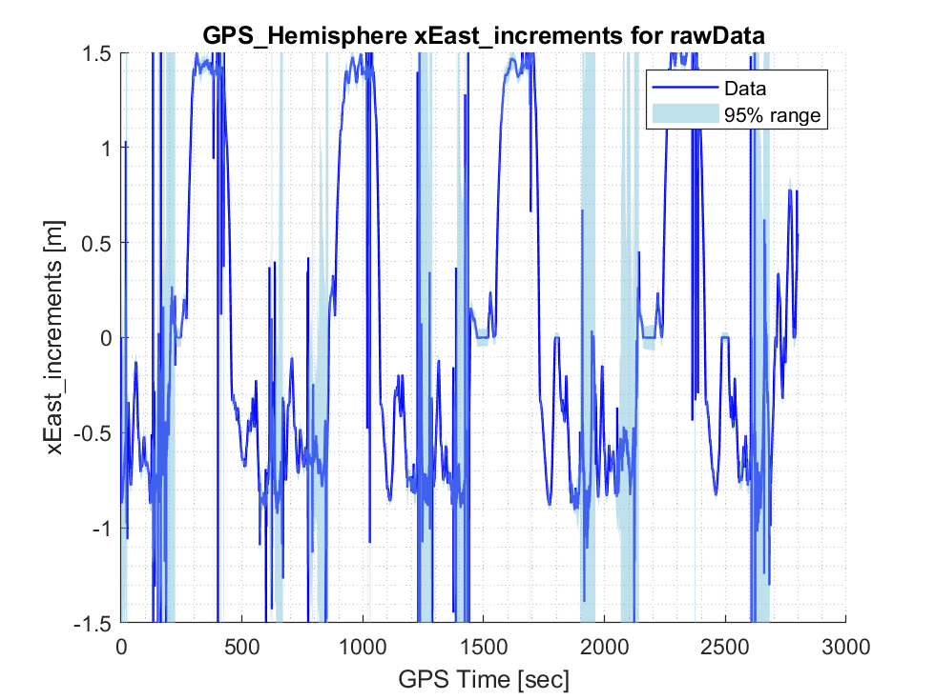
Here’s an illustration of the effects of results on x increments
Raw Data

Slide 37
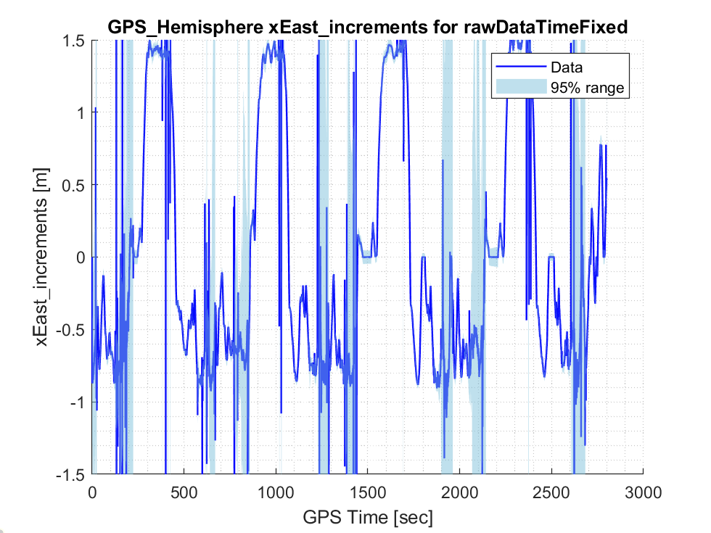
Here’s an illustration of the effects of results on x increments
Raw Data after Time Fixed

Slide 38

Here’s an illustration of the effects of results on x increments
Raw Data after Time Fixed and Sigma values added

Slide 39
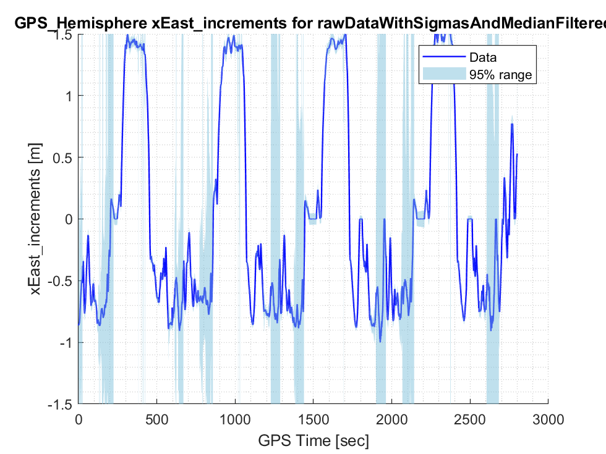
Here’s an illustration of the effects of results on x increments
Raw Data after Time Fixed and Sigma values added

Slide 40
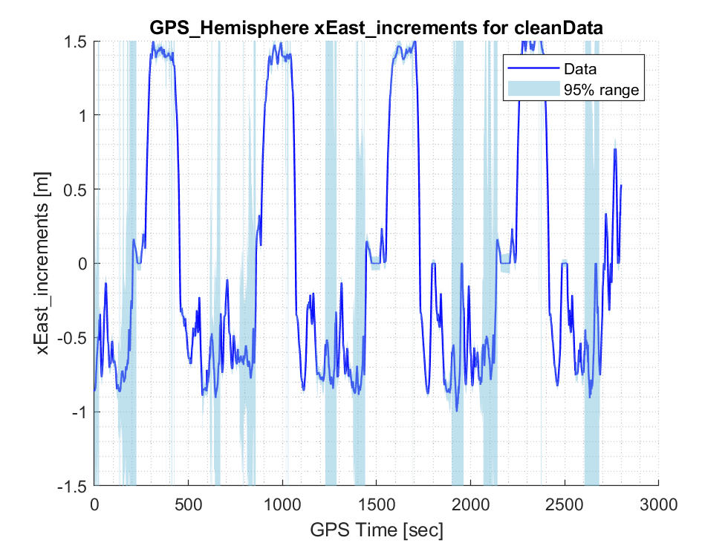
Here’s an illustration of the effects of results on x increments
Raw Data after Cleaned and Filtered

Slide 41
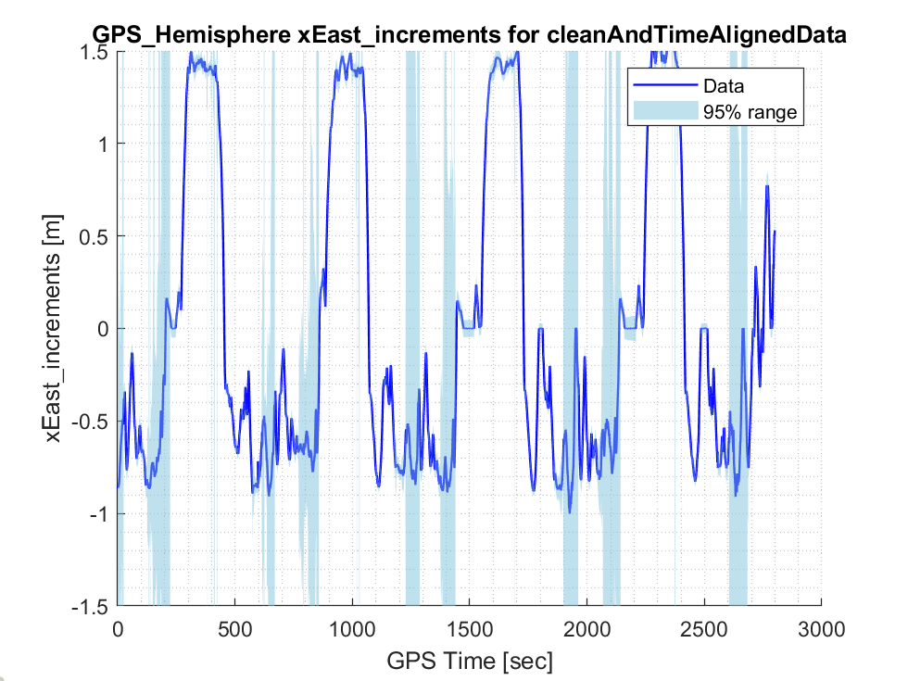
Here’s an illustration of the effects of results on x increments
Cleaned and Time Aligned

Slide 42
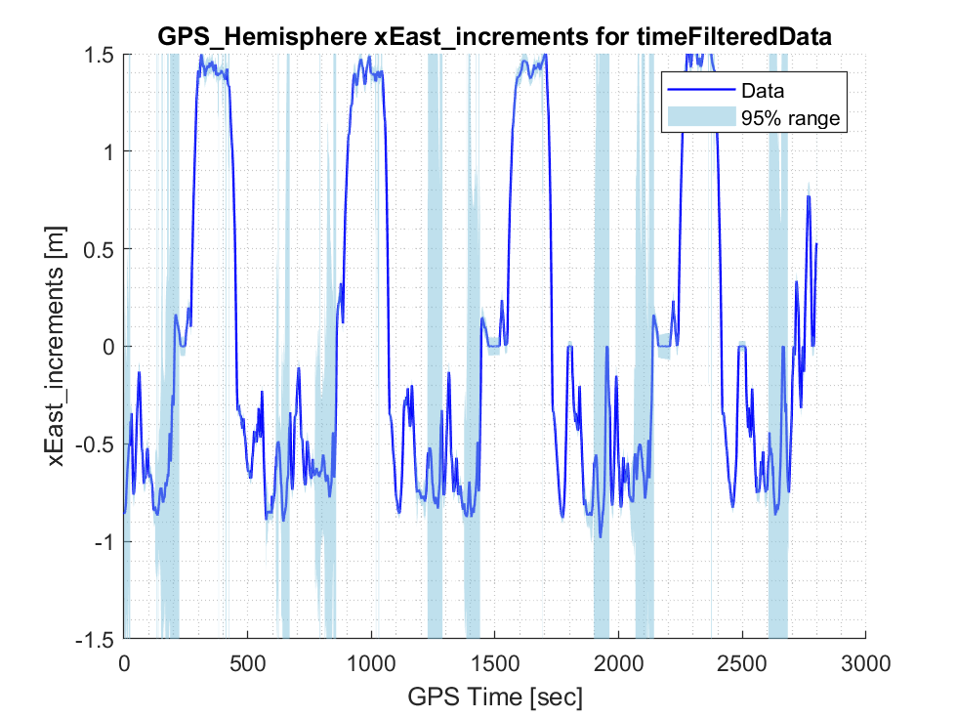
Here’s an illustration of the effects of results on x increments
After time filtering

Slide 43
Here’s an illustration of the effects of results on position plots (XY)
Raw Data

Slide 44
Here’s an illustration of the effects of results on position plots (XY)
Outliers removed

Slide 45
Here’s an illustration of the effects of results on position plots (XY)
Outliers removed

Slide 47
The Kalman Filtering cannot remove jump discontinuities, as these are not zero mean guassian processes
Instead, we use template matching within state-space plots.

Slide 48
Template matching is motivated by the data in state-space exhibiting odd jumps (this is Hemisphere xEast, rawData)

Slide 49
It’s especially hard to filter because it curves back onto itself in some locations, yet filtering it in time domain decouples the states.

Slide 50
To find jumps, we look at the cumulative sum of error between the predicted and actual increments, e.g. the per-station bias in the signal. Jump discontinuities are found by a threshold based on standard deviation.
Biases showing discovery of jumps Their location in state-space

Slide 51
Here’s a close-up of the jumps discovered via this process

Slide 52
At the start and end of the trajectory, we ensure that there is DGPS data. We can compare the skew of the predicted fit at start and end to estimate the skew in locations without DGPS.

Slide 53
With the data aligned, we can return the corrected prediction (using smooth predictions) or corrected increments (noisy but cleaned versions of the original increments)

Slide 54
Here’s some example results from key areas: (ydata from Hemisphere, 1st pair set)

Slide 55
Here’s some example results from key areas: (ydata from Hemisphere, 2nd pair set)

Slide 56
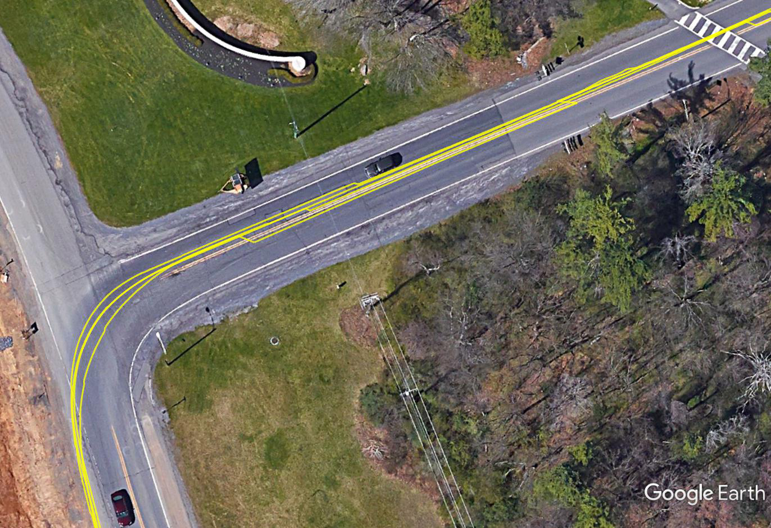
Here’s a comparison of the resulting XY plots in Google Earth (via the KML file)
Raw data at Toftrees turn toward I-99, showing merged with No Jumps

Slide 57
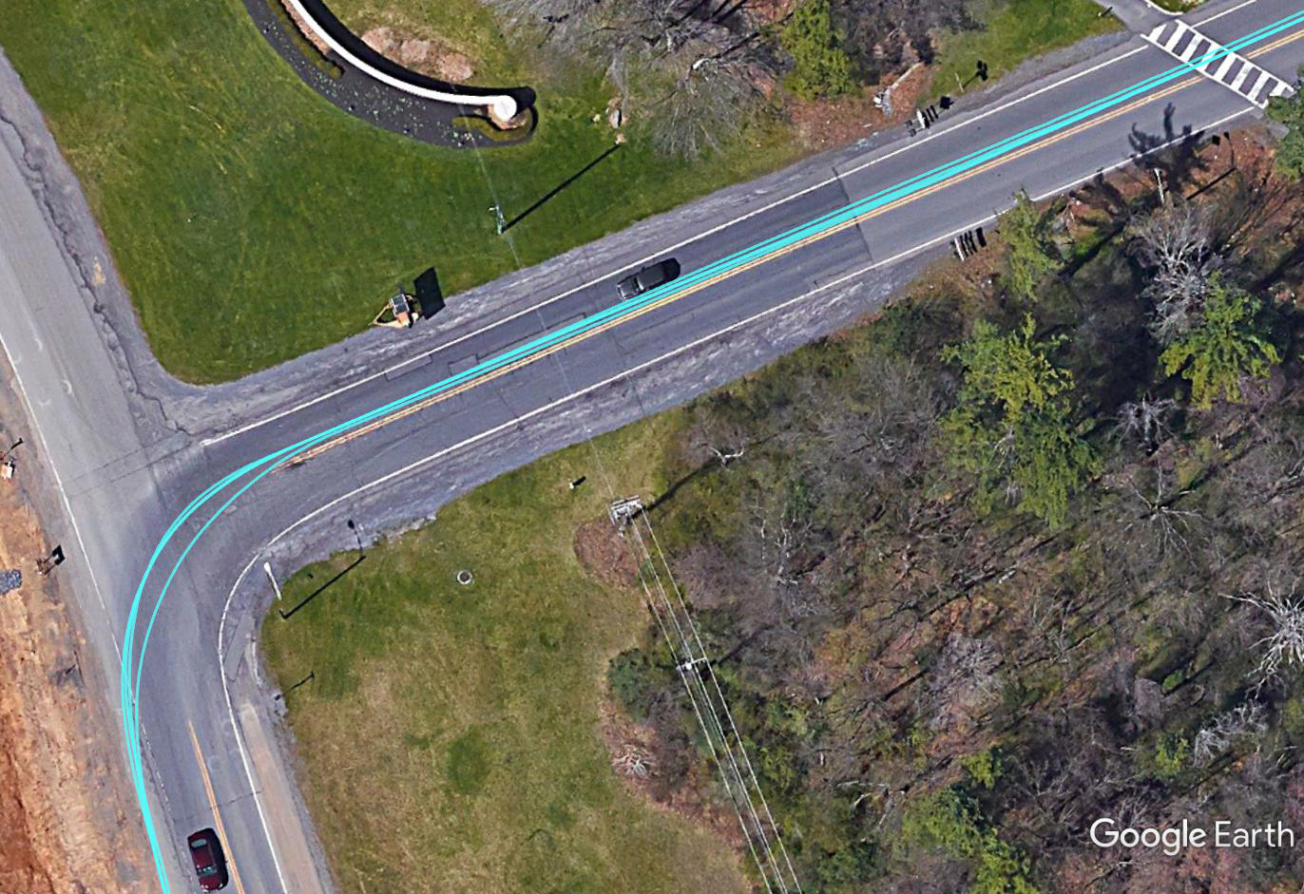
Here’s a comparison of the resulting XY plots in Google Earth (via the KML file)
Raw data at Toftrees turn toward I-99, showing merged with No Jumps

Slide 58
Station calculations: Station step 1: Define start and end of segments

Slide 59
Station step 2: Using start/end, automatically break data into laps (and/or routes)

Slide 60
Station step 3: Determine the s-coordinate average along each lap, removing outliers

Slide 61
Station step 4: Decimate data to the same s-coordinate

Slide 62
Many of the work we have done in this repo can be replaced by the MATLAB built-in Signal Processing functions
Check the Timetables data type for time-sampled data and corresponding functions.
It looks that Synchronize and fillmissing functions are useful.
Check Signal Processing Onramp course to learn methods for spectral analysis.

